Slide 1
ITC and Programming in C++
Number Systems
Lecture 2

Slide 2
Number Systems
Computer stores number, letters, and other special characters in coded form.
Two Types of Number Systems
  Non-positional Number Systems
  Positional Number Systems

Slide 3
Non-Positional Number Systems
In this system, each symbol represents the same value, regardless of its position in the number, the symbols are simply added to find out the value of particular number.
Example
  I for 1
  II for 2
  III for 3
  IIII for 4

Slide 4
Positional Number Systems
In positional number systems, there are only few symbols, called digits, and these symbols represent values, depending on the position , they occupy in the number.
The value of each digit is determined by three steps
  The digit itself
  The position of the digit in the number
  The base of the number systems
Examples
  Decimal number systems
  Binary number systems
  Octal number systems
  Hexadecimal number systems.

Slide 5
Binary Number Systems
As we know that decimal system the base is equal to 10. It means that there are 10 digits in decimal system i.e. 0,1,2,3,…,9.
Binary number system is same as decimal system, except that the base is 2, instead of 10.
In Binary System there are only two digits (0,1) , which can be used.
Each position in a binary system represent the power of base (2)
Example
= 16 + 0 + 4 + 0 + 1
= 21

Slide 6
Octal Number System
In Octal Number System, the base is 8.
So, there are eight digits: 0,1,2,3,4,5,6 and 7.
Each position in an octal number represents a power of base 8.
Example
= 1024 + 0 + 40 + 7
= 1071

Slide 7
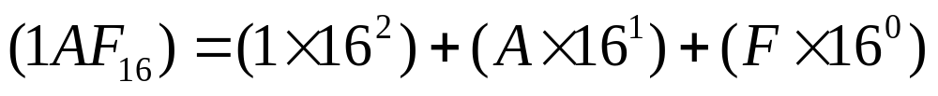
Hexadecimal Number System
In hexadecimal number system, the base is 16.
So, there are 16 digits or symbols in hexadecimal number system.
First 10 digits are 0,1,2,3,4,5,6,7,8,9.
The remaining six digits are denoted by the symbols A, B, C, D, E and F, representing the decimal values 10, 11,12, 13, 14 and 15, respectively.
Each position in the hexadecimal system represents a power of the base (16)
Example:
= (1 * 256) + (10 * 16) + (15 * 1)
= 256 + 160 + 15
= 431

Slide 8
Converting From One Number System To Another
Any number in one number system can be represented in other number system.
In computer system, the input and output is mostly in decimal number system.
So, computer takes input in decimal and convert it into binary than process the input and converts again in decimal to produce output. Which is understandable to user.

Slide 9
Converting to Decimal from Another Base
Three steps.
  Determine the column value of each digit (this depends on the position of the digit and the base of the number).
  Multiply the obtain column values by the digits in the corresponding columns.
  Sum the products calculated in step 2. The total is equivalent value in decimal.

Slide 10

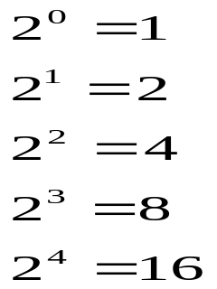
Converting to Decimal from Another Base
Example
  Step 1: Determine the values.
  1
  2
  3
  4
  5
  Step 2: Multiply Column values by corresponding column digits
  (1x16) + (1x8) + (0x4) + (0x2) + (1x1)
  Step 3: Sum the product
  16 + 8 + 0 + 0 + 1 = 25

Slide 11
Converting From Decimal to Another Base
Four Steps
  Divide the decimal number to be converted by the value of new base.
  Record the remainder from Step 1 as the right most digit of the new base number.
  Divide the quotient of the previous divide by the new base.
  Record the remainder from step 3 as the next digit (to the left) of the new base.
  Repeat Step 3 and 4 until the quotient becomes zero.

Slide 12
Converting From Decimal To Another Base
Example
2 42 remainder
21 0
10 1
5 0
2 1
1 0
0 1
Hence 42 = 101010

Slide 13
Converting From a Base Other Than 10 to a Base Other than 10
Two Steps
  Convert The original number into decimal number system
  Convert the decimal number obtained in step 1 to the new number.

